Slide 1
19Z701 - CRYPTOGRAPHY

Slide 2
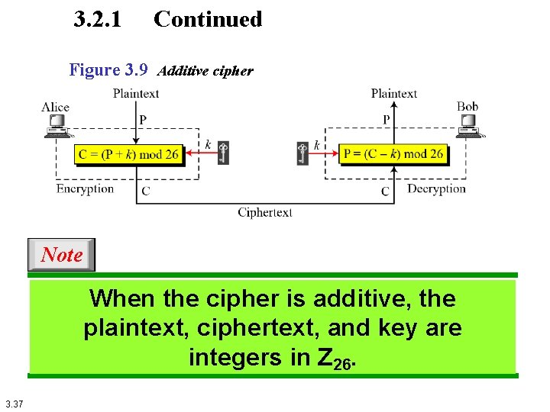
Additive Cipher

Slide 3
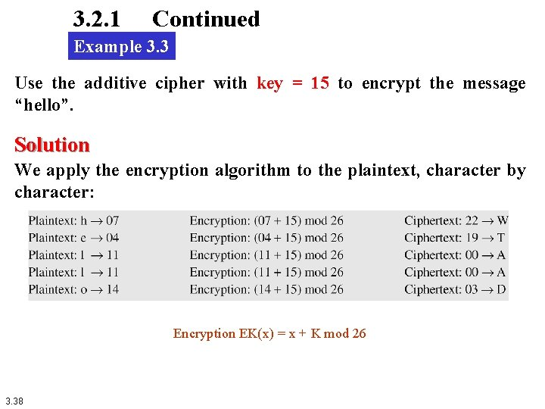

Slide 4
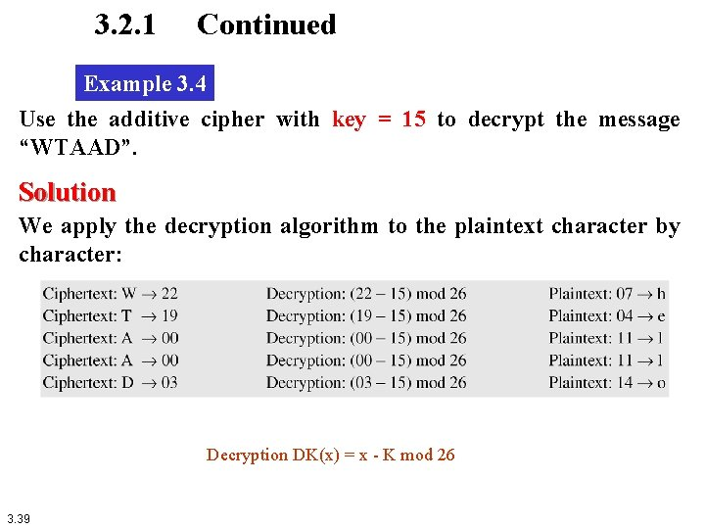

Slide 5
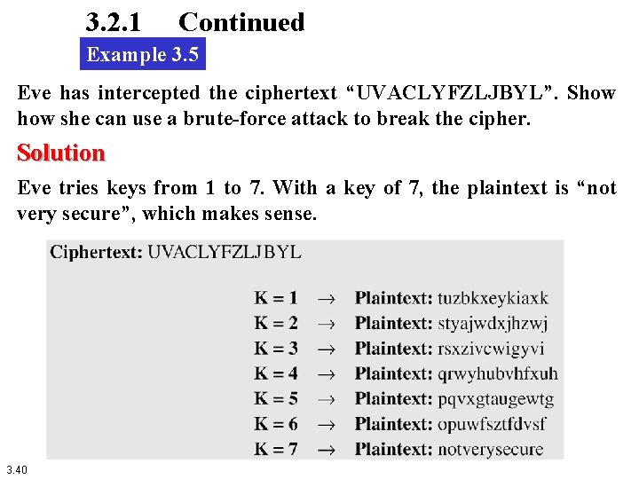


Slide 6
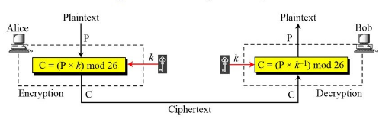
Multiplicative Cipher

Slide 7
Encryption
C = E(K,P)=(P*K) mod 26

Slide 8
Decryption
Decryption algorithm :
P=D(K,C)=(C*K⁻¹) mod 26

Slide 9
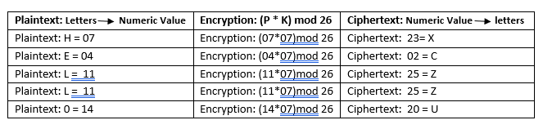
Example
encrypt the message "HELLO" using multiplicative cipher with key = 7

Slide 10
Table of Multiplicative Inverse
we must use a multiplier which is co-prime (the values do not share any factors when dividing in relation to the size of the alphabet (26), so you should use either 1, 3, 5, 7, 9, 11, 15, 17, 19, 21, 23 or 25.
key a | key a⁻¹
1 | 1
3 | 9
5 | 21
7 | 15
9 | 3
11 | 19
15 | 7
17 | 23
19 | 11
21 | 5
23 | 17
25 | 25

Slide 11
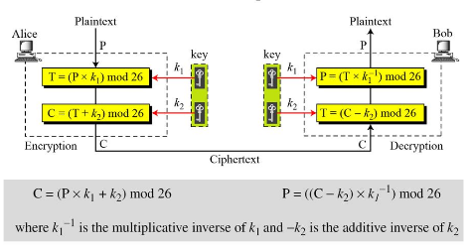
Affine Cipher

Slide 12
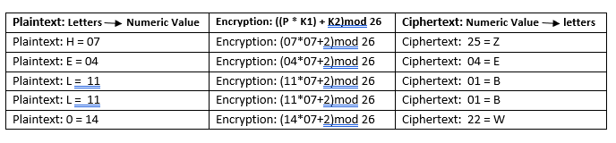
Example
Encrypt the message "HELLO" using Affine Cipher with key pair (7,2)
So, the ciphertext is " ZEBBW"

Slide 13
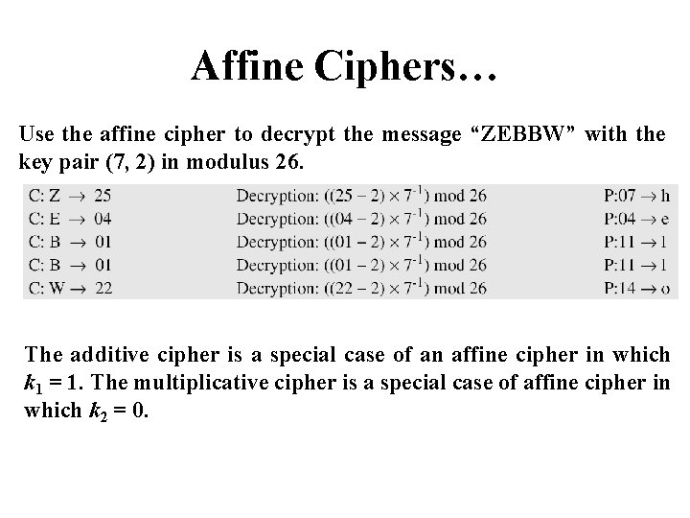

Slide 14
Thank You

